Slide 1

Morse Code Translator
By: Mukund Soni 191372
Shivam Verma 191455

Slide 2
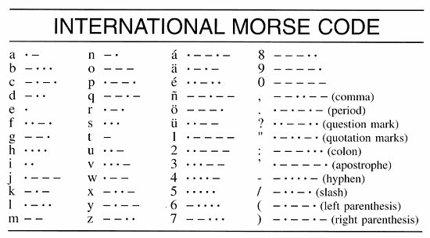
What is Morse Code?
Morse code is a method used in telecommunication to encode text characters as standardized sequences of two different signal durations, called dots and dashes or dits and dahs.

Slide 3
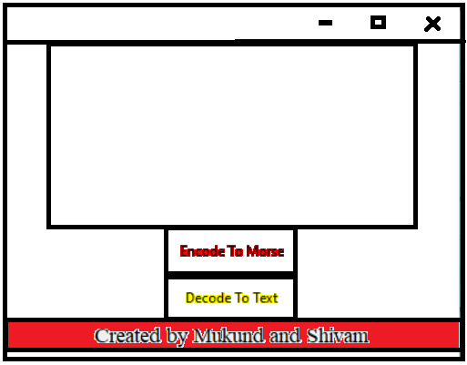
Design/Framework
Creating Simple Tkinter GUI toolkit
Designing GUI which contain a Text Box to get Morse Code as a Input with 2 Button to run Decode Command and Encode Command
Creating a New Window Displaying Decoded Morse Code

Slide 4
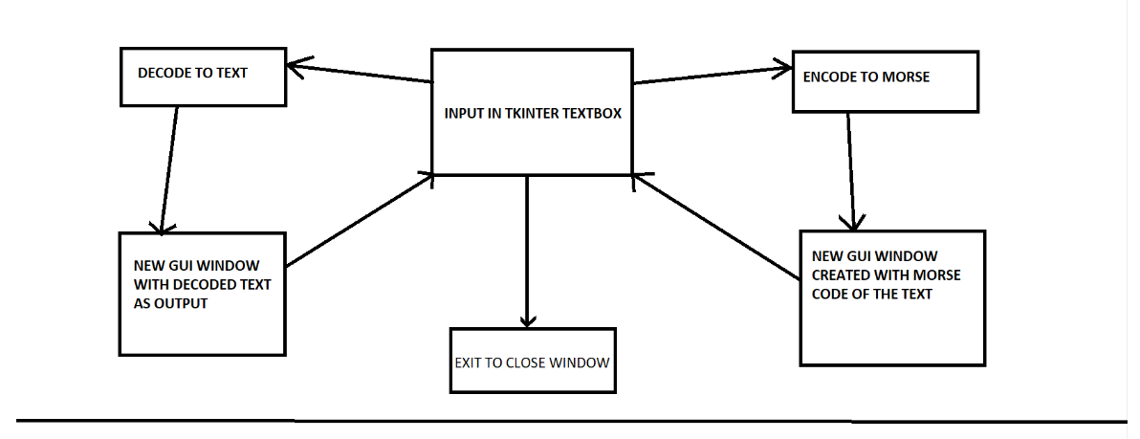
CONTROL FLOW

Slide 5
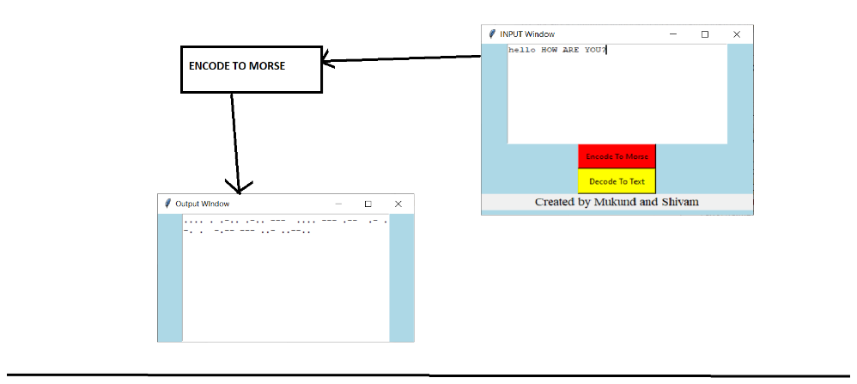

Slide 6
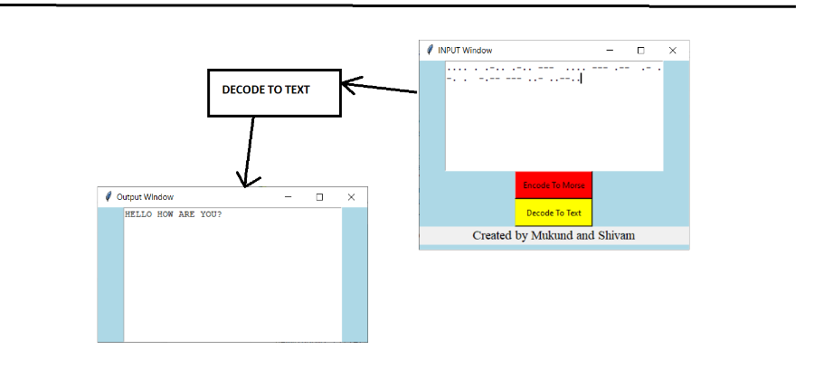

Slide 7
Algorithm for Decoding
MORSE_DICT = { '.-':'A', '-...':'B', '-.-.':'C', '-..':'D', '.':'E', '..-.':'F', '--.':'G', '....':'H', '..':'I', '.---':'J', '-.-':'K', '.-..':'L', '--':'M','-.':'N', '---':'O', '.--.':'P', '--.-':'Q', '.-.':'R', '...':'S', '-':'T', '..-':'U', '...-':'V', '.--':'W', '-..-':'X', '-.--':'Y', '--..':'Z', '.----':'1', '..---':'2', '...--':'3', '....-':'4', '.....':'5', '-....':'6', '--...':'7', '---..':'8', '----.':'9', '-----':'0', '--..--':', ', '.-.-.-':'.', '..--..':'?', '-..-.':'/', '-....-':'-', '-.--.':'(', '-.--.-':')','':" "}
i = input()
list1 = []
list1= i.split(" ")
print(list1)
Input : .--- ..- .. - ... --- .-.. .- -.
Output: ['.---', '..-', '..', '-', '', '...', '---', '.-..', '.-', '-.']
list2 = []
for i in list1:
list2.append(MORSE_DICT[i])
str1 = ""
x = str1.join(list2)
print(x)
Output: JUIT SOLAN
Creating a Dictionary in Python which contain Morse codes as Key and Decoded text as Values of respective keys
Get Input from User as Morse Code and store it in a List after splitting it in list1
Create another List as list2
Use "For i in list1" append all the Elements in list2 as MORSE_DICT[i]
Use .join(list2) to create a String and return it.

Slide 8
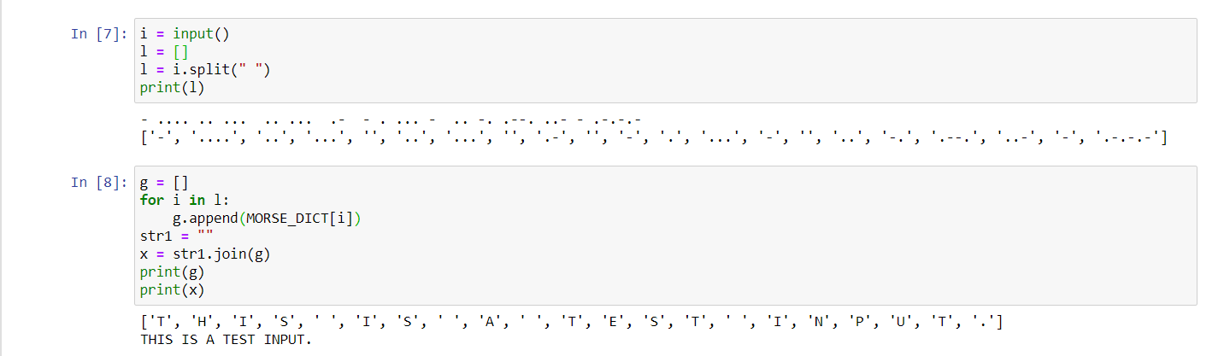
Code INPUT and OUTPUT

Slide 9
Algorithm for Encoding
i = input()
list1= []
i = i.upper()
for j in i:
list1.append(j)
list2= []
for i in list1:
for key, value in MORSE_DICT.items():
if i == value:
list2.append(key)
print(list2)
str1 = " "
x = str1.join(list2)
print(x)
Get the Input from User and convert it to upper letters to make it compatible with Dictionary.
Append Each letter in list1
Using "Double For loop" to find key form Dictionary and Append it in another list2
Join it with spaces to convert in string to form Morse code.

Slide 10
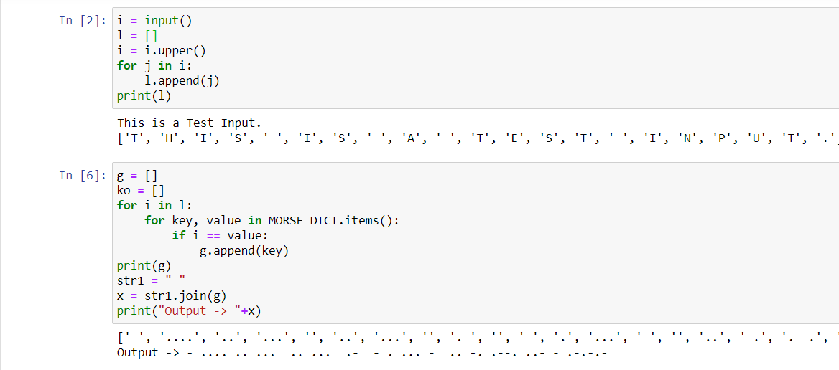
Code INPUT and OUTPUT

Slide 11


Algorithm for Tkinter
Create an empty Tkinter GUI
Add a Text Box and a Button in the GUI
Create a command to run when button is pressed.
Command creates a new GUI Window and Displays the result.

Slide 12
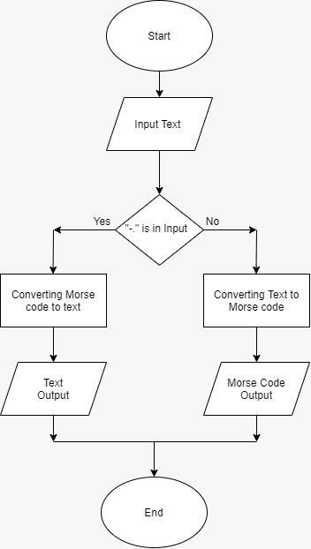
FLOWCHART

Slide 13
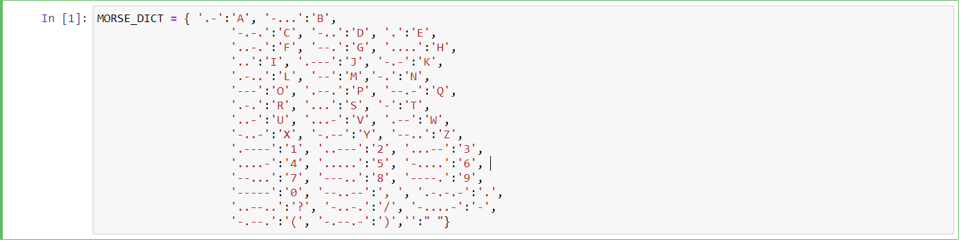
Morse Code Translator Python
Creating A Dictionary:

Slide 14
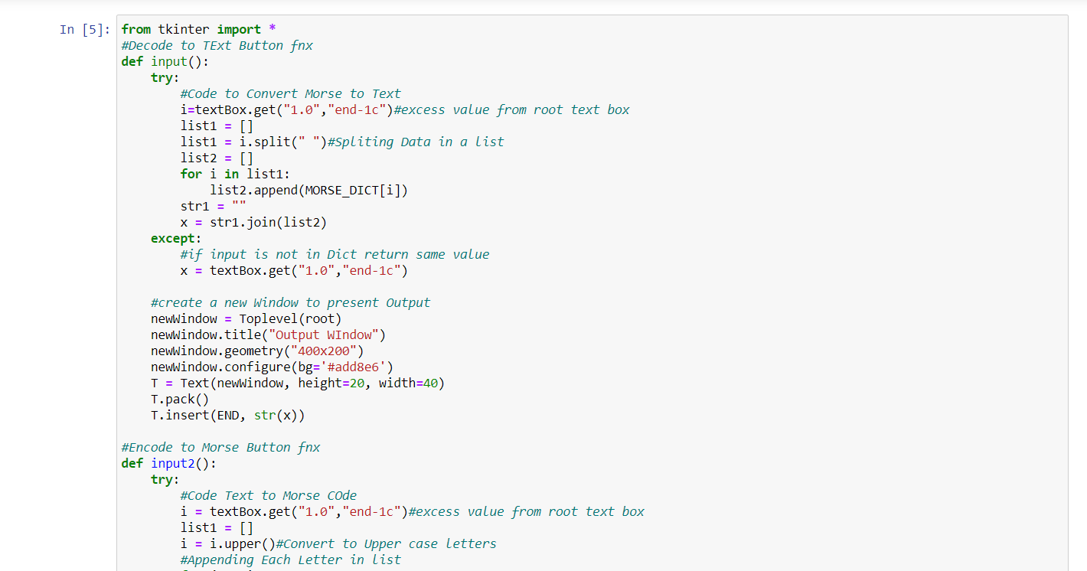

Slide 15
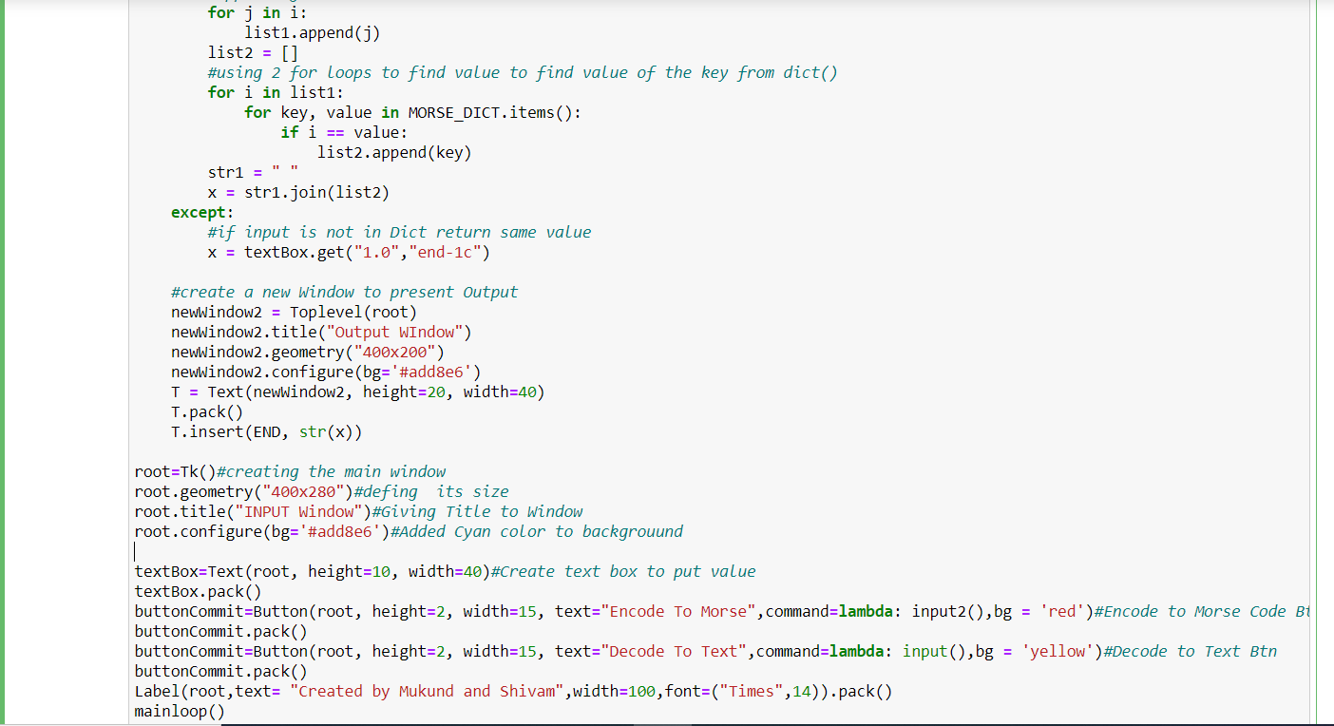

Slide 16
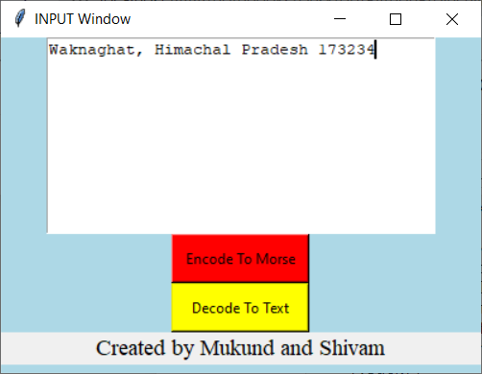
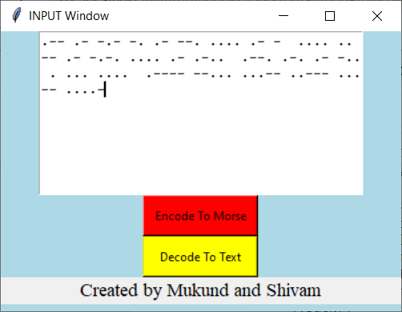
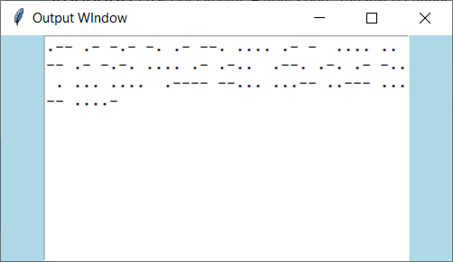
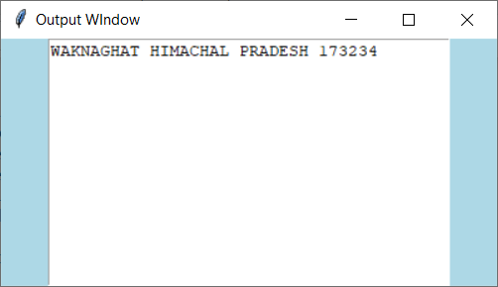
Output of The Code

Slide 17
RESULT
Python provides a data structure called dictionary which stores information in the form of key-value pairs which is very convenient for implementing a cipher such as a Morse code. We can save the morse code chart in a dictionary where (key -value pairs) => (English character – morse code). The plaintext (English characters) takes the place of keys and the ciphertext (Morse code) form the values of the corresponding keys. The values of keys can be accessed from the dictionary in the same way we access the values of an array through their index and vice versa. We know that we have hashmaps in python which is a form of data used to find the frequency of characters in a string. () Basically a dictionary is like a list instead of integer index it can be of any type.to define a dictionary we use a key value pair with a colon between them iter () method returns an iterator for the given object .in case of sentinel provided, it returns the iterator object that calls the callable object until the sentinel character isn’t found. We need to import the dictionary by calling the function MORSE_CODE_DICT (). We can use any of the python compilers like python 3.7(32bit). or any other online python compilers .so for fast output we can use online python compilers.

Slide 18
Refrences
Images:
768 × 768 (google.com)
375 × 422 (google.com)
Morse Code | Definition of Morse Code by Merriam-Webster (google.com)
Text:
Morse code - Wikipedia

